Slide 1


VistaCommerce
VistaCommerce
E-Commerce Company’s Path to Sustainable Growth
Powered by Data-Driven Insights | Power BI Dashboard Showcase
Presented by: Vartika Jain Date: 14th July 2025

Slide 2

About the VistaCommerce
VistaCommerce is a growing fashion-focused e-commerce company serving customers across major Indian cities. Despite increasing order volumes, the company is facing several operational challenges, including high cancellation rates, uneven sales performance across weekdays, and fulfillment inefficiencies.
To address these issues, VistaCommerce aims to leverage data-driven insights from its transactional data to improve customer satisfaction and optimize sales and logistics.

Slide 3


Problem Statement
The company aims to analyze sales performance, cancellation trends, and customer behavior to inform its business decisions. This dashboard offers a snapshot of key metrics and patterns derived from historical order data.

Slide 4





Order_ID: A unique identifier assigned to each order was placed in the e-commerce system.
Order_Date: Date on which the product was ordered.
Order_Status: Current status of the order (e.g., Shipped, Cancelled, Delivered to Buyer, etc.)
Order_Category: Category of the product.
Amount: Amount of the transaction.
City: Details about the location to which the product was shipped.
Dataset Overview

Slide 5

DAX Formulas
Total Revenue
Cancelled Orders %
Total Revenue =
Cancelled Orders% =
Average Order Value
Average Order Value =
AVERAGE(sales_dataset[Order_Amount])
SUM(sales_dataset[Order_Amount])
DIVIDE(
CALCULATE(COUNTROWS(sales_dataset), sales_dataset[Order_Status] = "Cancelled"),
COUNTROWS(sales_dataset)
)
Total Cancelled Orders
Total Cancelled Orders = CALCULATE(COUNTROWS('sales_dataset'),'sales_dataset’[Order_Status] = "Cancelled")

Slide 6

Key Performance Indicators (KPIs)
KPI | Value | Insight
💰 Total Revenue | ₹71.77M | Strong top-line performance
❌ Cancelled Orders % | 14.22% | High — needs investigation
📦 Average Order Value | ₹556.62 | Low-cost or bulk orders
❌ Total Cancelled Orders | 18K | Significant number of failed orders
📊 Top-Selling Category | Set (₹35.78M) | Also has highest cancellations
📈 Peak Sales Month | April (₹26.3M) | Seasonal trend
📈 Peak Sales Day | Sunday (₹11M) | Weekend demand spike

Slide 7
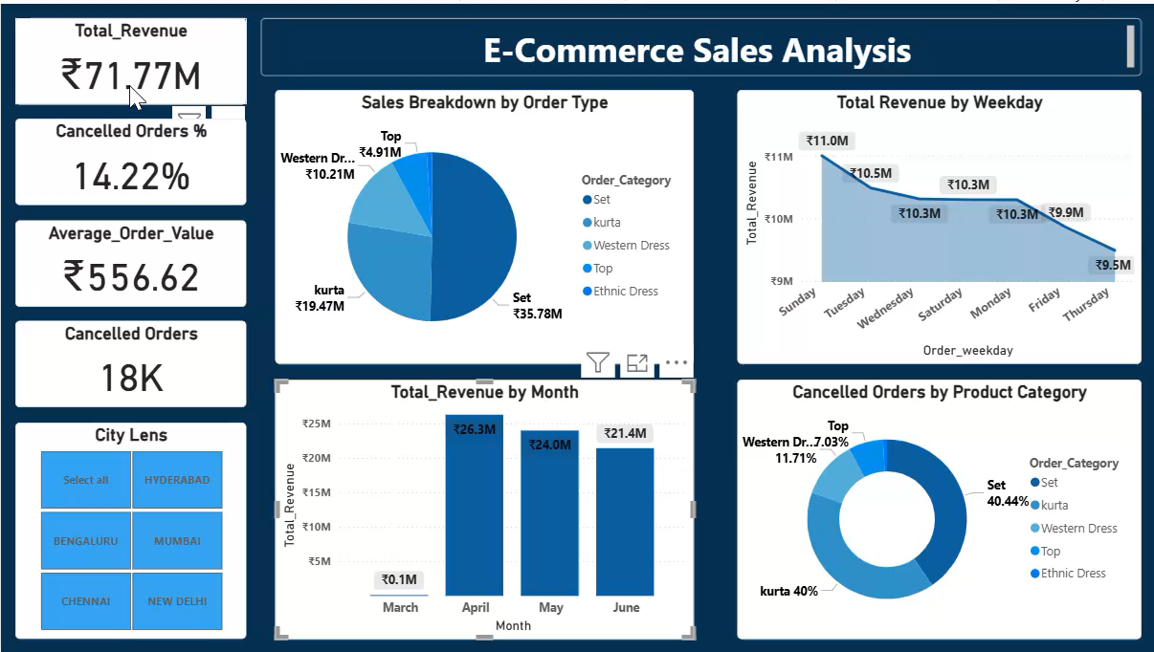
Dashboard Walkthrough

Slide 8
Sales by Category
Highest Revenue: Set (₹35.78M)
Top Contributors: Kurta, Western Wear
Insight: Set category performs best, but also shows the highest cancellations

Slide 9
Set: 40.44% cancellation
Kurta: 40.03%
Western Dresses: 11.6%
Suggestion: Focus on quality, product display, or fulfillment for these categories.
Cancellations by Category

Slide 10
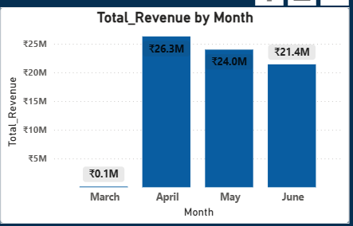
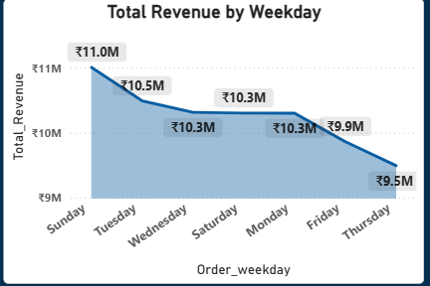
Sales Trends (Time-Based)
Highest revenue: April (₹26.3M)
Best weekday: Sunday (~₹11M)
Lowest: Thursday (~₹9.5M)
Action: Run campaigns on weekends, and we should investigate weekday drops.

Slide 11
Conclusion
The Dashboard provides a clear view of revenue, cancellation trends, and product performance.
Despite strong total revenue (₹71.77M), the cancellation rate is high at 14.3%.
The Set category, though the top revenue generator, also has the highest cancellation rate (40.46%).
Sales peak during April and on Sundays, indicating clear seasonality and weekday patterns.
The average order value (₹556.62) suggests a price-sensitive audience or bulk ordering in low-cost segments.

Slide 12
Investigate High Cancellations
Focus on the Set, Kurta, and Western Dresses categories.
Check for issues in sizing, quality, delivery timelines, or mismatches in product descriptions.
Leverage Peak Sales Days
Run targeted promotions on Sundays and during peak months like April.
Consider flash sales or loyalty rewards on low-performing weekdays (e.g., Thursdays).
Utilize Regional Filters
Use city-based insights to tailor offers, stock, and delivery speeds.
Focus marketing in top-performing cities.
Optimize Inventory
Prioritize stocking bestsellers like “Set” while monitoring cancellation trends.
Balance supply for high-demand styles with quality assurance checks.
Recommendation
For
VistaCommerce

Slide 13



Connect with me
VistaCommerce
Email
jainvartika03@gmail.com
LinkedIn
https://www.linkedin.com/in/vartika-jain-2043ab212/
GitHub
https://github.com/Vartika-DA?tab=repositories

